Slide 1
Lifelong Learning in Palestine: Building in LL under Conditions of Closure and Siege
Islamic University of Gaza
Dr. Hatem Elaydi
Prof. Hala Khozondar
Dr. Fahid Rabah
April, 2013

Slide 2
Learning throughout the lifespan: learning that is from cradle to grave,
starting at any age and in any circumstances

Slide 3
Palestinian Education Minster: Lamis Al Alami
The whole Gaza Strip is under siege. We need at least 200 new schools in order to accommodate the growing number of children in Gaza. We cannot talk about the right to education without talking about all the related rights.
Children undergoing trauma as a result of all the violence that has happened to them, how can these children concentrate on what is being taught to them or whatever happens in the classroom.

Slide 4
Outlines:
Introduction
Palestine: Gaza Strip
Islamic University of Gaza (IUG)
Leadership from the Ground Up
Culture as Site of Memory
Economic Issues
Pedagogy
Gaza as a learning region
Summary

Slide 5
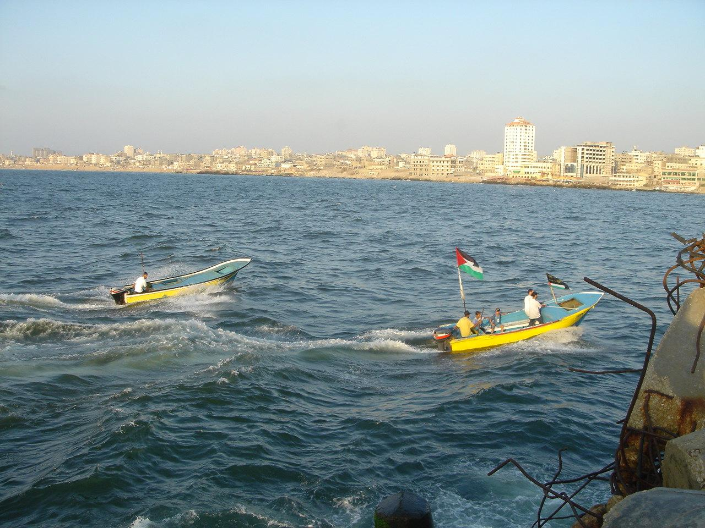
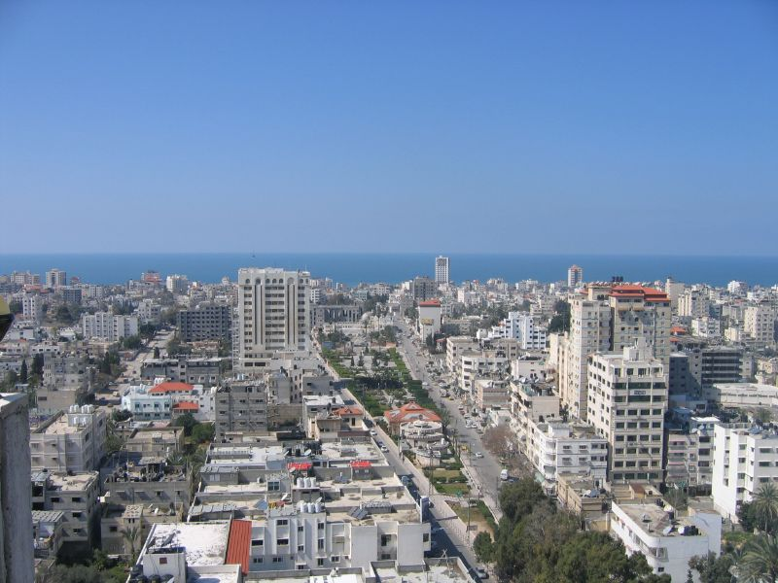
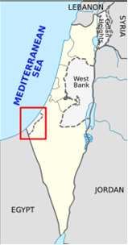
Gaza is about 41 kilometers long, and between 6 and 12 kilometers wide, with a total area of 360 square kilometers.
Population is 2 million people

Slide 6
Overview on higher education
There are seven universities in Gaza, and several two years colleges.
The programs are carefully chosen such that they cover a wide range of different areas and avoid duplications.
Universities in Gaza and colleges are growing very fast to host students from Gaza and to cope with the fast growing technology.
They equip students with the right tools to be able to serve their community.

Slide 7
Islamic University of Gaza (IUG)
IUG was established in 1978.
IUG strives to be the leading Palestinian University working to develop educational and cultural standards in Palestinian society according to professional Values and Principles.
IUG is a member of four associations: International Association of Universities, Community of Mediterranean Universities, Association of Arab Universities and Association of Islamic Universities.
IUG endeavors to advance learning, foster the expansion of knowledge through teaching and research and encourage community service. In fulfillment of this purpose, we hold the following strategic plans at the heart of our endeavor:
  1. Encouraging scientific research.
  2. Promoting local & global academic cooperation in different fields.
  3. Developing the utilization of IT in university operations.
  4. Enhancing the quality of education and quality assurance process.
  5. Enhancing university policy, accountability, and decision making process.

Slide 8
Gaza is a Lifelong Learning Region
Lifelong learning is present in Gaza and is part of Palestine as a learning society.
Learning is present in a range of institutions: family and kindergarten, NGO projects, schools, universities, civil societies, unions, religious institutions and local government.
Learning takes a range of forms: circles of young people learning together, University lecture halls, technologies assisting the visually impaired and disabled, business incubation projects and breast feeding projects.
Learning takes place in a range of places: homes, IT laboratories, playgrounds, needlework and knitting studios, art classroom, libraries, shops, offices and clinics.
Learning takes place across a range of population: children learning with parents and grandparents, and NGO experts teaching Human Rights seminars and conflict transformation.

Slide 9
Gaza is a Lifelong Learning Region …
Learning is present in a range of modalities: academic lecture, conversations between women in communities play areas, seminar debate and workshop dialogue, entrepreneurial, civic and political engagements, and modalities of spiritual reflection.
Gaza is a learning society possesses remarkable resources of skills, knowledge and creativity which come from the unlawful occupation, aggression and siege imposed by Israel.
These conditions have developed a new form of education which breaks all the barriers that the Israeli imposes on Gaza.
Students studied under harsh circumstance including war and arbitrary killing processes.

Slide 10
Leadership from the Ground Up
Youth leaders, IUG IT incubator
Trustee leaders, IUG
Spiritual leadership through values,
Academic and research leaders in the community (IUG benchmarking)
Managers as leaders (NGOs and spinouts)
Distributed leadership within clear structures (universities)
Excellent governance (in Universities and NGOs)
Leadership forms and spaces (Kindergraten and safe play areas to University lectures)

Slide 11
Leadership from the Ground Up …
Leadership for civil society, conflict transformation, mediation and advocacy
Leadership for employability (government programs, UNRWA program, special initiatives)
Leadership in non-violence (PNGO Gaza)
Leadership for the transformation of Palestinian society
Leadership for cultural heritage and preservation(IUG, Art & Craft Village, Almathaf)
Leadership for media and cultural communication (Alketab, UNRWA Satellite Channel)

Slide 12
Culture as Site of Memory
In Gaza, several cultural areas need to be restored where they are currently closed due to lack of enough funds.
IUG cultural heritage centre –Iwan succeeded to get some fund to preserve some of these cultural sites.
The Oral History Centre at IUG.
Irada is a running project helps victims of wars on Gaza to survive, includes a program to teach the victims of wars arts and crafts.
Private owned museums to preserve the Palestinian heritage such asAl-Mthaf.
In Gaza, several NGOs encourage young as well as elderly people to preserve the old crafts and arts such as: Art and Craft Village, Biet Alsmod, Graduate Women Society, Women Union, Alhaq Fe Alhiya, Banana Alsom and others.
Ibdaa “creativity” studies and training foundation

Slide 13
Culture as Site of Memory …
Ibdaa “creativity” studies and training foundation
Gaza Museum of Archaeology, Al-Mathaf
Center for Architectural Heritage, IWAN
Arts and Crafts Village

Slide 14
Economic Issues
The Work of IUG’s Department of Continuing Education, of PNGO and of the Women Graduate’s Society is an excellent example of intervention into the desperate economic conditions to foster new businesses and skills.
Graduate unemployment is a serious aspect of the situation in Gaza and in the absence of a lifting of the siege and the blockage of the Port of Gaza it is clear that there is only limited prospects of economic development based on materials.
It is extremely difficult for goods to be imported and exported internationally.

Slide 15
Economic Issues …
Potential consultancy themes:
  Biomedical responses to siege/trauma
  Trauma and Education: Recovery and Consequences with limited Resources
  Women in Science and Gender Equality: Lessons from Islam
  Patent development (Optometry – example)
  De-salination
  High Intensity Agriculture and Food Production for high density populations
  Values of mediation are found across Gazan society and discussion of violence occurs within families on a regular basis.
  Reusing the debris of the wrecked houses, factories and governmental building.

Slide 16
Pedagogy
Whilst quantitative benchmarks for learning and equality are impressive across Palestine, especially with regard to matters of literacy, there is considerable scope for developing the pedagogical basis of Gaza as a learning society.
Much of the pedagogy remains a teacher/expert centred approach and does not align within the University settings or schools with the learner centred approaches which enhance autonomy and emancipator leadership potential.

Slide 17
Pedagogy … Highlighted issues related to lifelong learning pedagogies and education:
The more highly educated you are in Gaza the less likely you are to have a job.
Need for universities to shift the focus on educational methods in teacher training.
There is partnership between IUG and Gaza Mental Health Program.
There is a trauma center at University College of Applied Science.
UNRWA is ill-equipped to deal with the issue of 19-20% of school children with learning difficulties and mental health issues.
Al-Haq fe alhaya (right to live) is a NGO which care for the children with Dawn syndrome.
Alsom (The deaf children) society helps deaf children to have better chances during their studies.
The benchmarking highlights good practice at IUG in offering tailored courses for local society.

Slide 18
Gaza as a Learning Region
Gaza can already be affirmed as an extraordinary learning region and an example of some of exemplary practice in lifelong learning worldwide.
This comes through values of spirituality, tenacity, hope, justice and longing which combine with creativity and a respect for education.

Slide 19
Summary
Gaza has fought for the survival of learning under the brutal conditions of siege.
The qualities and strengths of Gaza as a learning Society are listed below:
  Leadership qualities in Gaza as a Learning Society: Dignity, Pride, Tenacity, Hope, Generosity of spirit, Faith, Confidence, Determination to build peace through justice, Competence, Excitement, Delight, Joy, Smart tactics, and Professionalism
  Leadership Strength comes from: Allah/God, Just cause, Suffering, Feeling of kinship, Giving light, Patience, and Better to try and not succeed than not to try at all

Slide 20


