Slide 1

Using social media to enhance HEI reputation & regional engagement
John Tibbitt
Hon Senior Research Fellow, University of Glasgow
Policy Analyst, PASCAL International Observatory

Slide 2
Aims
Promoting the work of both
the HE institution and its staff
What can social media deliver in this context?
How do social media fit alongside more conventional approaches?
How to use social media effectively?
How to assess impact?

Slide 3
Social media platforms
Facebook
Twitter
Linkedin
Youtube
E-newspapers
Blogs
Wordpress
Blogspot
Academia
Web forums

Slide 4
Why use social media?
HEIs
Creating awareness – breaking news and commentary
Engaging with partners, customers & other stakeholders – responding to customer requests
Monitoring – learning about users’ response to HEI provision
Learning from others – sharing good practice
Rapid response to emerging issues
Market testing
Extending access and participation

Slide 5
Why use social media?
Academic centres and staff
Creating awareness of work
Targeting distribution of news
Monitoring a field of knowledge
Sharing ideas and work in progress
Network building
Engaging with audiences outside instituions
The ‘public academic’

Slide 6
Effective use
Develop a strategy
Develop a style
Quality content
Link to other media
Get organised

Slide 7
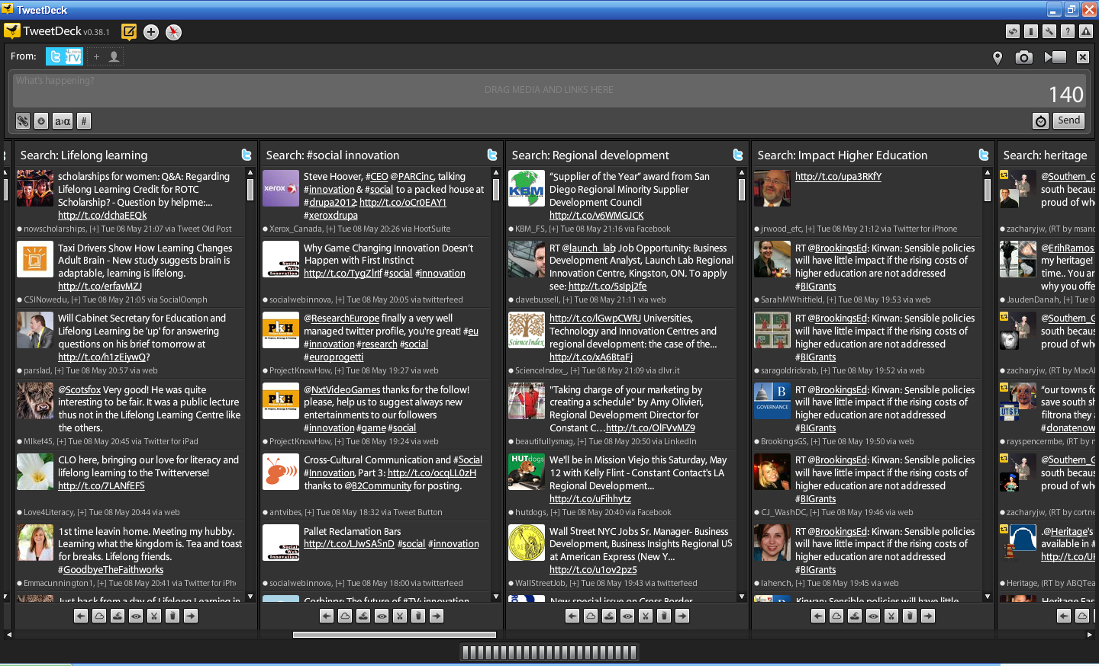
Organising tweets

Slide 8
Assessing Impact
Twitter
Numbers/profiles of followers
Retweets /mentions
Direct messages
Lists
Facebook
Numbers/profiles of fans
Reach
Engagement

Slide 9
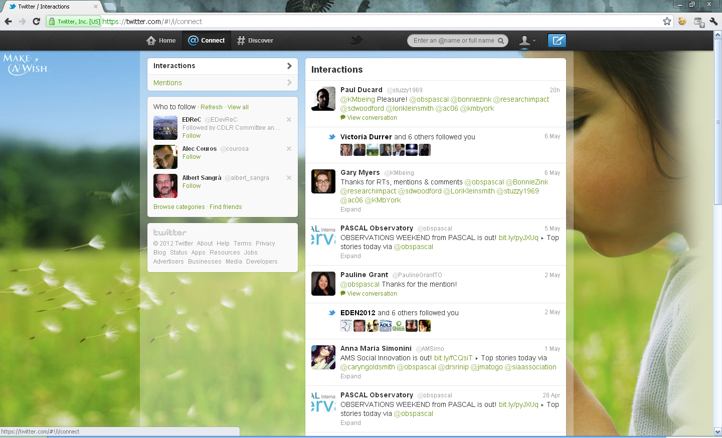
Twitter interactions

Slide 10
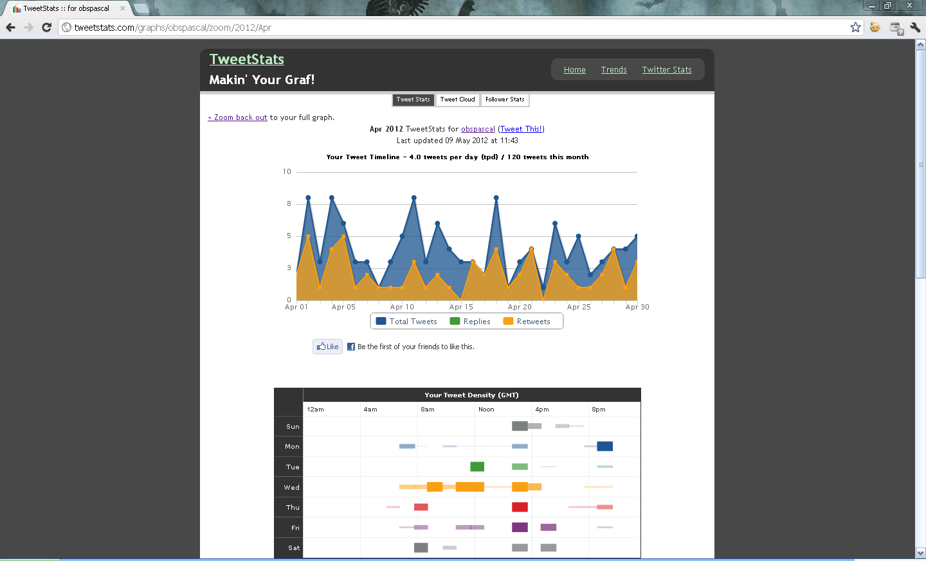
Tweet stats

Slide 11
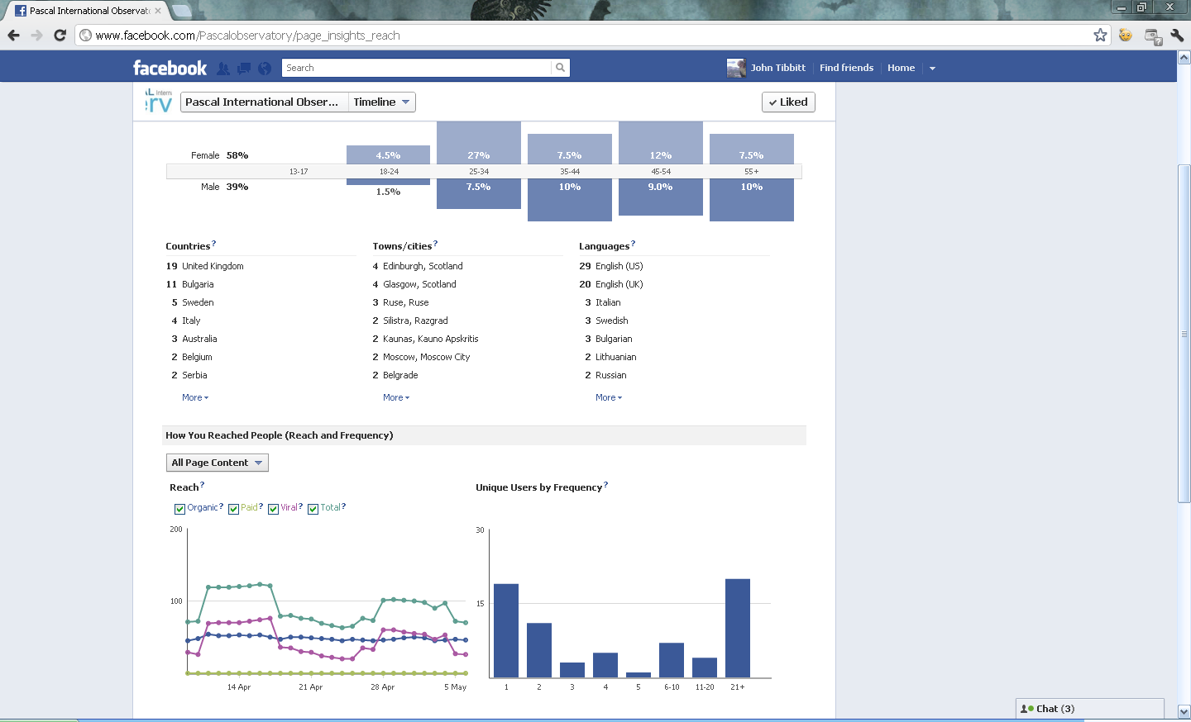
Reach

Slide 12
More
Social media for in business, see for example McKinsey Quarterly http://www.mckinseyquarterly.com/Marketing/Digital_Marketing/Demystifying_social_media_2958
Guide to social mobility for teaching research and impact, see LSE blog http://blogs.lse.ac.uk/impactofsocialsciences/2011/09/29/twitter-guide/

Slide 13
Thank you for listening
Twitter joke!
Tweet and Retweet are in a boat. Tweet falls out.
Who is left? Retweet.
John.Tibbitt@gla.ac.uk

Slide 14
PASCAL on-line
Website: www.pascalobservatory.org
Twitter: www.twitter.com/obspascal
Facebook: www.facebook.com/Pascalobservatory
E-papers:
OBSERVATIONS: www.bit.ly/qOMppe
OBSERVATIONS Weekend: www.bit.ly/pyJXUq

