Slide 1
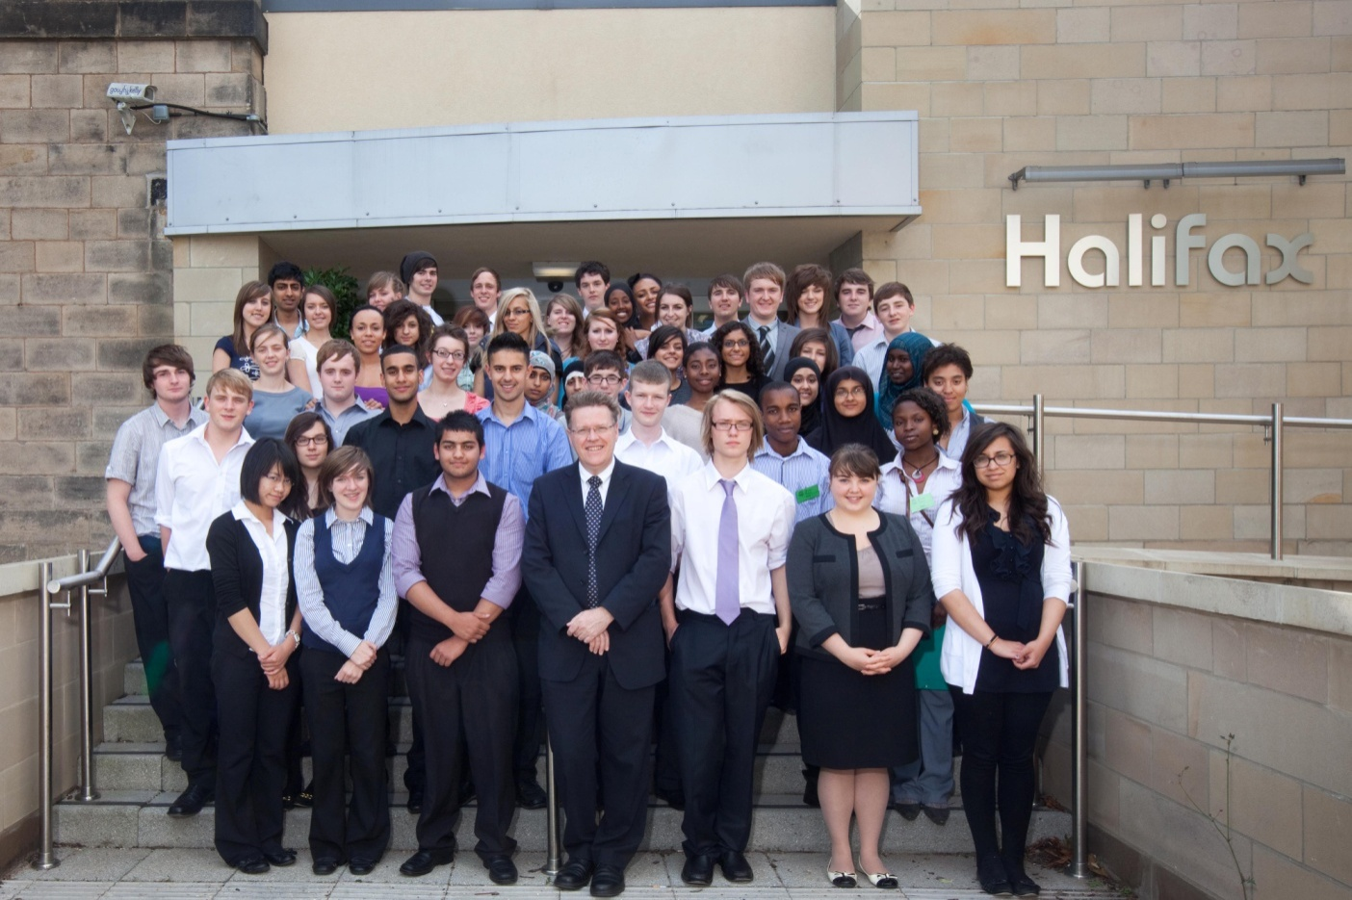

A Sense of Belonging
How the SOAMS model promotes social change in communities local to Sheffield

Slide 2
Key Themes
1. Access to professions – political backdrop
2. Case studies
3. SOAMS ‘model’
- how we target local communities
- programme structure
4. Reflections on the scheme
- key features and what the future holds?

Slide 3
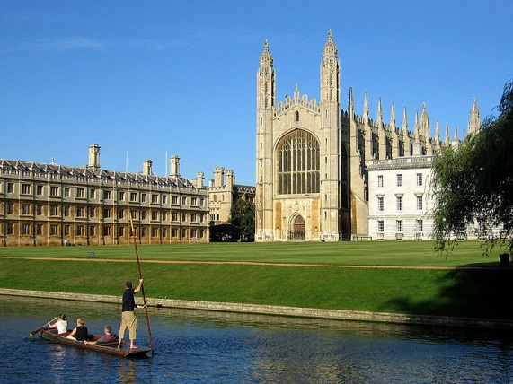


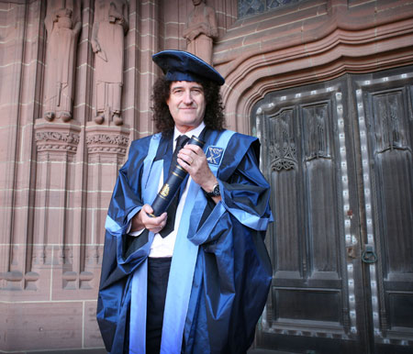
Various reports have stated that access to the professions is key to promoting social mobility
Alan Milburn 2009 report on Access to the Professions
Not for the likes of me!
Notes:
National recognition for the scheme – OFFA paper 2010 case study – slightly misquoted

Slide 4


Slide 5

Established 2001
Broad aim
To make a career in Medicine a possibility for students from backgrounds underrepresented in HE and the medical profession

Slide 6

Case studies from ex-SOAMS students
Student A
Female
Sheffield school with low progression rate to HE
Parents did not attend university themselves
Studying Medicine at Sheffield
Works as ambassador

Slide 7

Student B
Male
GCSEs – School in Chesterfield – very low progression rate
A-Levels at high achieving secondary school
Neither parent attended university
Studying Medicine at Sheffield
Works as ambassador

Slide 8
Key themes emerging from case studies
Lack of awareness of HE and Medicine/ lack of family knowledge
Student A
‘ I had always heard of university but at the time I didn’t really understand what it was all about. Nobody in my circle of family and friends had been to university so we never really spoke about what it was.’

Slide 9
Student B
‘I was extremely apprehensive about any career involving university simply on the basis of my very little knowledge about university coupled with the fears my parents had regarding the financial implications. My parents don’t hold degrees and do not know anyone with a degree education, so were initially apprehensive about my ideas of university education.’

Slide 10
Lacking confidence
Student A
‘I knew that in order to study Medicine I had to go [to university] but I never thought I would actually get there!’
Student B
‘I was scared by the preconception that university was full off higher class students, with backgrounds completely different to me, who I would never be able to integrate with.’

Slide 11
Sense of achievement
‘Ecstatic! I remember thinking what a great opportunity I had been given.’
‘I was very proud, as was my entire family ... I was excited that I was getting the unique opportunity to ‘test the waters’ in the concept of higher education and see it for myself. I knew I was hardworking and quite clever and now I had the chance to really push myself and excel. It was an opportunity I couldn’t miss or fail.’

Slide 12
Support from schools vital
Student A
‘When I was in primary school I was always told how good I was at Science...One of my tutors at college had heard of the SOAMS scheme and encouraged me to apply. I think he was the first person to really believe in me.’

Slide 13
Exposure to university environment vital
Student A
‘I had lived in Sheffield for a long time but had never been to the part of the city where the university is. When I walked onto the concourse everything was so exciting... The atmosphere was amazing and I remember thinking to myself how ‘cool’ it was – it was completely unexpected.’

Slide 14
Student B
‘It was a very unique feeling standing in the middle of the student union, an insignificant little pupil in a sea of students rushing past in the daily life. It was very exciting and spurred me on to think more and more about medicine.’
Notes:
Medical focus important – but very often about a gut instinct that this feels right.

Slide 15
Ex - SOAMS students as ‘role models’
Student B
‘A friend of my family is going through the A-Level process and I’ve been asked to go back to my old school to give her and others some support about the medical school process, interview techniques, UCAS form help etc.’

Slide 16
‘I also helped mentor a student with SOAMS e-mentoring and he has been accepted in to medicine at a London based medical school.
I think if you know people like you that have made it into medicine, it really helps you relate to the concept that you can do it too.’

Slide 17
Student A
‘I feel really privileged to have had the opportunity. This has driven me to continue to be involved with the scheme throughout medical school as an ambassador and also encouraged me to get involved on a national scale with the BMA to ensure that all students have the same opportunities that I had.’
Interviewed for newsbeat
MSC Executive Lead on WP
ISC Chair for Sheffield Medical School
Notes:
Intra School Committee

Slide 18
Reflections on case studies
SOAMS aims to support young people in overcoming barriers – real and perceived
Ex-SOAMS students as role models – vital to success of scheme
Is there more we can do with regard to role models going forward?

Slide 19
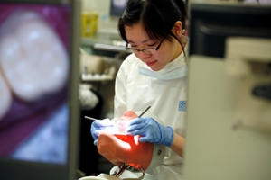
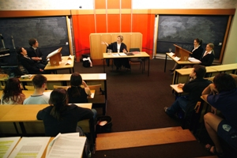
‘Sense of Belonging’
The SOAMS Model
SOAMS model – how we target communities in Sheffield and surrounding regions
Raise awareness, aspiration, achievement
Model can be applied to other outreach schemes

Slide 20
SOAMS targeting guidelines
(most able least likely)
First generation HE
Need to study locally or
Have personal circumstances that may limit aspirations
Good in Science and Maths – top 10%
Parental occupation – NS-SEC
Postcode – IMD
*Currently reviewing for “basket of indicators*

Slide 21
SOAMS Targeting
Targeting communities through school contacts
Still get support that school/college offers – but can build relationships with individuals and their families – strong networks
Risk factor – losing school contacts
Selective scheme - sense of achievement and source of motivation for students

Slide 22
Two Distinct Phases:
PHASE 1 Places
Year 9 90
Year 10 90
Year 11 90
PHASE 2 Places
Year 12 up to 45
Year 13 up to 45

Slide 23
SOAMS Phase 1 Activity Programme
Year 9 | Year 10 | Year 11 | Ongoing support, advice and guidance
1.) Welcome Evening | 1.) Team Building Challenge Day | 1.) Sheffield Hallam and Department Visit
2.) ACE Day | 2.) Thackray Medical Museum | 2.) First Aid
3.) Medicine :Fact or Fiction? | 3.) DNA and Ethics | 3.) GCSE Study Skills
4.) Chemistry and Microbiology | 4.) Powerlab | 4.) Celebration Evening
General HE/Skills Development
Medical Science Guidance and support

Slide 24
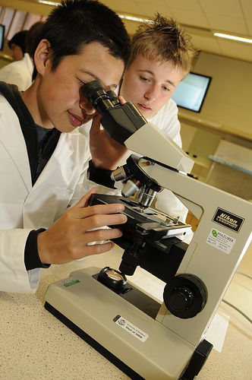
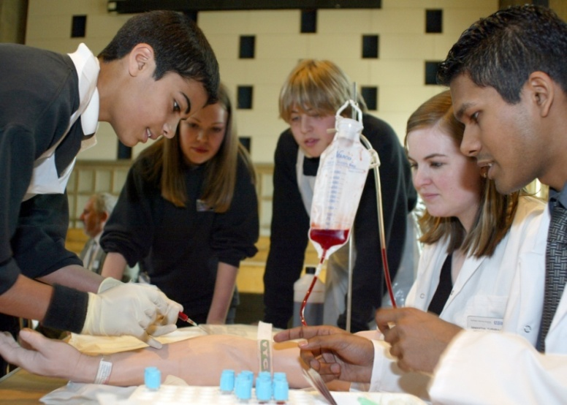
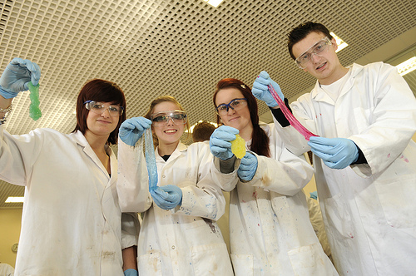

Slide 25
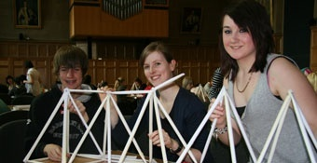
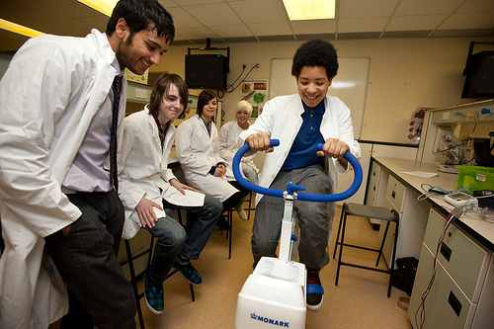
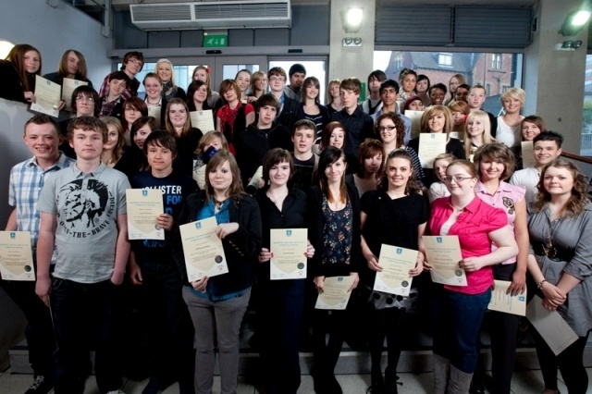

Slide 26
SOAMS Phase 2 – Programme of Activities
General HE/Skills Development
Medical Science
Guidance and support
Year 12 | Year 13 | Ongoing support, advice and guidance Evaluation and tracking E-mentoring Tailored, one-to one support GI
Welcome Event and E-Mentee Training | UCAS Application Session
Medical Careers Conference | NEW SESSION!
Mini-ILA | Hollowford Team Building Day
AS Study Skills | One-to-one session
Chemistry Revision | Medical School Interview
Optional Biology Revision | A Level Study Skills (Uni prep)
Open Day | Chemistry Revision
Summer School | Celebration Evening

Slide 27
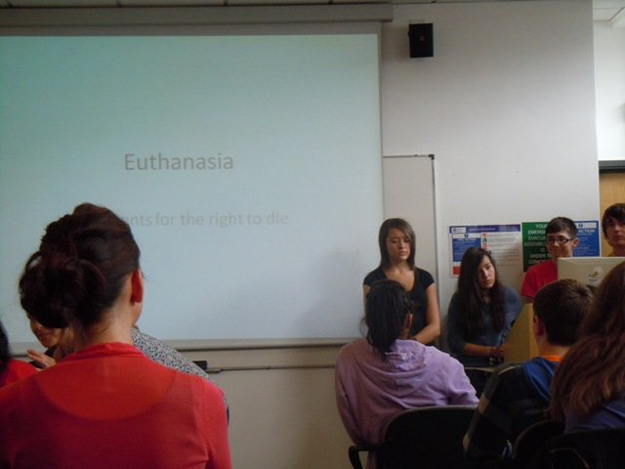
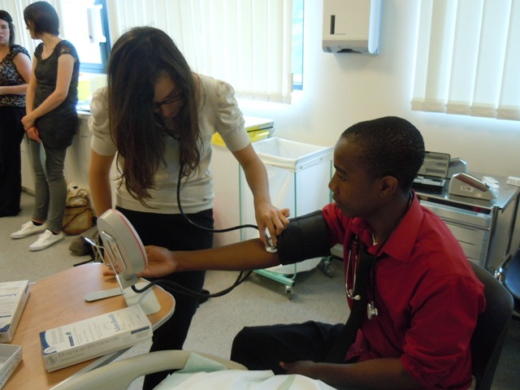

Slide 28
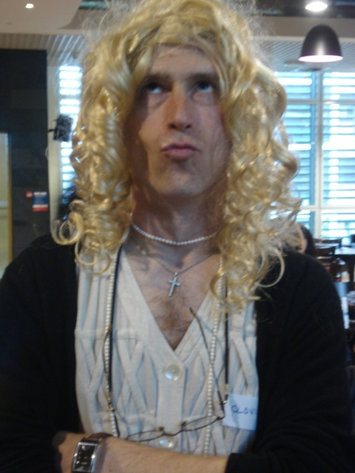
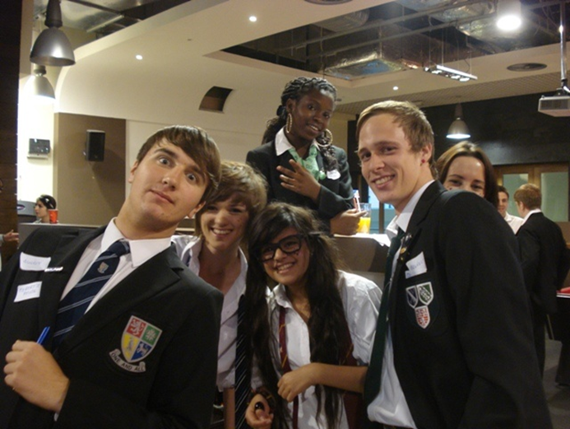
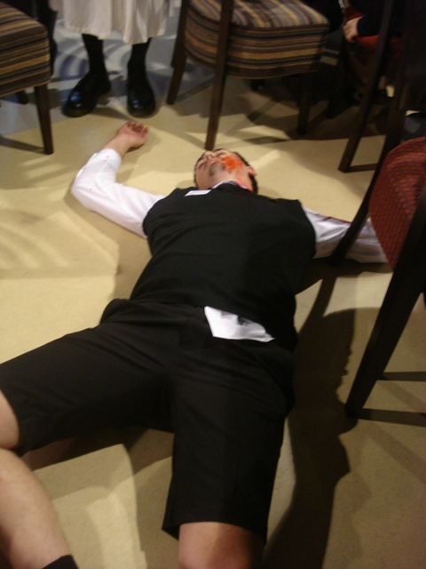

Slide 29

Key Features of the programme
Guaranteed interview =
Use of ambassador role models vital to success of scheme & *within communities*
‘Lobbying’ force within university – able to operate at various levels – not just us – our ambassadors too! Can be political.
Notes:
Exemplar of cultivating ambition - Mission Vision and Identity Statement – 3 members of staff – can vary focus – work with medical school

Slide 30
Additional support for students
Not a rigid programme
Tailored support – large programme but can intervene at individual level
Able to spot trends and offer appropriate, timely support i.e. one-to-one sessions

Slide 31
SOAMS Destinations
Summary of results of SOAMS students surveyed over the telephone
Date | Response rate | Starting uni | Defers | In FE no plans | Other | Working | Failed resits
2008 | 87% | 74% | 15% | 5% | 2% | 3% | 1%
2009 | 82% | 68% | 6% | 4% | 3% | 6% | 11%

Slide 32
Conclusions
SOAMS a robust model that can demonstrate success in driving the agenda forward – not in isolation
Ex-students form networks and promote WP in wider community
Could be applied to other outreach schemes – ADOPT, PPP etc

Slide 33
Future considerations
Student finance
Greater work with departments
Changes to targeting guidelines
Promote Sheffield as a good choice
Build on work with role models

Slide 34
100
Years
Of
Excellence.

Slide 35
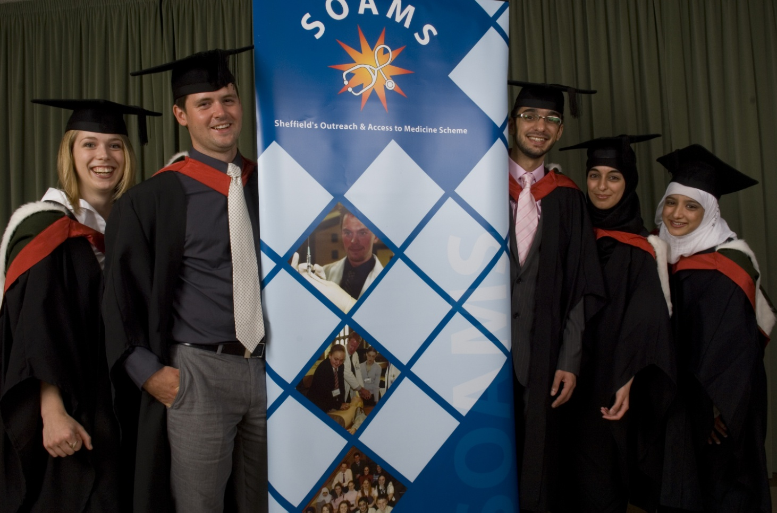
SOAMS Graduates

Slide 36
Quotes
“I gained a far better understanding of the different aspects of the medical profession”
“The Summer School was really fun”
“Now I know that medicine is definitely for me”
“The mock interview helped me to prepare for the real thing”
“The UCAS guidance was excellent”
“SOAMS gave me confidence to apply for medical school”
“A most valuable insight into medicine as a career”
“Excellent support and guidance”

