Slide 1
University & Community Engagement through Continuing Education: University of Waikato and the Rauawaawa Trust
Professor Brian Findsen
Faculty of Education
University of Waikato
New Zealand

Slide 2
Overview
Characteristics of Aotearoa New Zealand
Broader societal context
Pakeha (European) and Maori Adult Education
Players in the partnership (University CCE and the kaumatua trust)
ACE funding for universities
Issues and threats

Slide 3
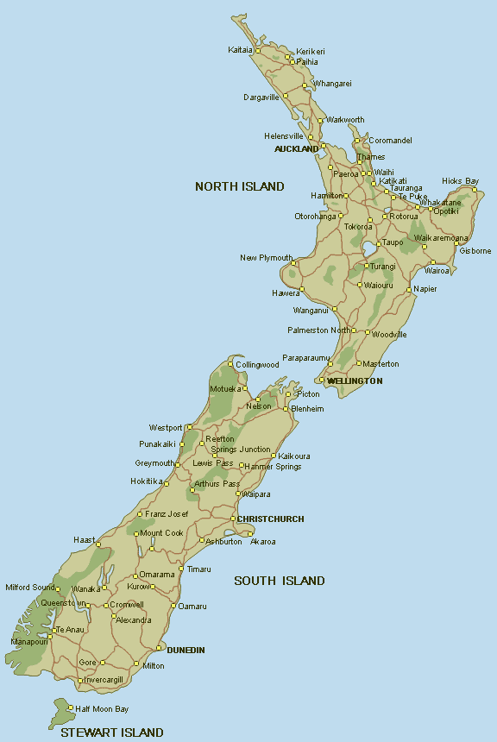
Geography:
New Zealand

Slide 4
Characteristics of Aotearoa New Zealand
Small population (4 million) - size of Britain
Colonised by Britain (bread basket for UK)
Ethnically diverse: majority Pakeha (European); 15% Maori; 12% Pasifika; 5% Asian
Auckland as magnet (1/3rd of population), especially for new immigrants
Founded on egalitarian principles (equality of opportunity)
Political stability (MMP voting system from late 90s)
Strong tradition of social justice (e.g. Women’s suffrage in 1893)
Primacy of the Treaty of Waitangi (signed in 1840). Emergent principles of protection, partnership & participation.
Current drive towards bi-culturalism, alongside multi-culturalism

Slide 5
Broader societal context
Advent of ‘Rogernomics’ akin to ‘Thatcherism’ from 1984 (Labour Government)
Neo-liberalism:
Deregulation to free market
Privatisation of education (PTEs)
Cult of efficiency (downsizing of public sector)
Supposed ‘choice’
Contestability of funds (e.g. research)

Slide 6
Pakeha Adult & Community Education
Effects of colonisation: British style institutions (e.g. WEA, university extension; trade union education) i.e. reproduction of social institutions (derivative)
Major domains of adult education: ABE, ‘second chance’, personal development, cultural education (e.g. refugees), education for community development – Tobias, 1996.
Emergent Kiwi tradition in Maori education, parent education, women’s studies, community arts, rural development (e.g. REAPs)
ACE Govt funding criteria: targeting learners whose initial learning was not successful; raising foundation skills, strengthening social cohesion
Older adult education – strong U3A movement.

Slide 7
Maori Adult & Community Education
Less well documented (oral traditions of Maori)
Historically, always a lifelong and life-wide learning culture
Strong individual leadership (e.g. Ranginui Walker; Linda Tuhiwai & Graham Hingangararo Smith)
Adoption of kaupapa Maori perspective (akin to Freirean philosophy)
Education reflective of societal structures: ancestral canoes, gender differentiation, preservation of ‘sacred’ knowledge via specialists, collectivist orientation, high status of elders (kaumatua)

Slide 8
Players in the partnership: Centre for Continuing Education
Historically, University of Waikato (UOW) gained independence from University of Auckland in early 1960s
Centre for Continuing Education (CCE) a strong participant in continuing education in Hamilton and region
Resources aplenty in 1980s
Innovator in several areas: Maori education; women’s studies; trade union education
In education, Certificate in Maori Studies conducted by CCE part of Maori tino rangatiratanga (self determination)
Exemplary practice of certificate: co-ownership of curriculum; preserved mana (prestige) of local Maori

Slide 9
Players in the partnership: Rauawaawa Kaumatua Trust
Established to strengthen cultural identity among elders; provide holistic services
Not usual to focus on older people (as opposed to youth emphasised by Government policy)
Trust serves an urban kaumatua population though groups also come from region
Varied learning activities: Maori language, healthy eating, cloak-making, songs, speech-making, flax-making, cloak-making, computer literacy

Slide 10
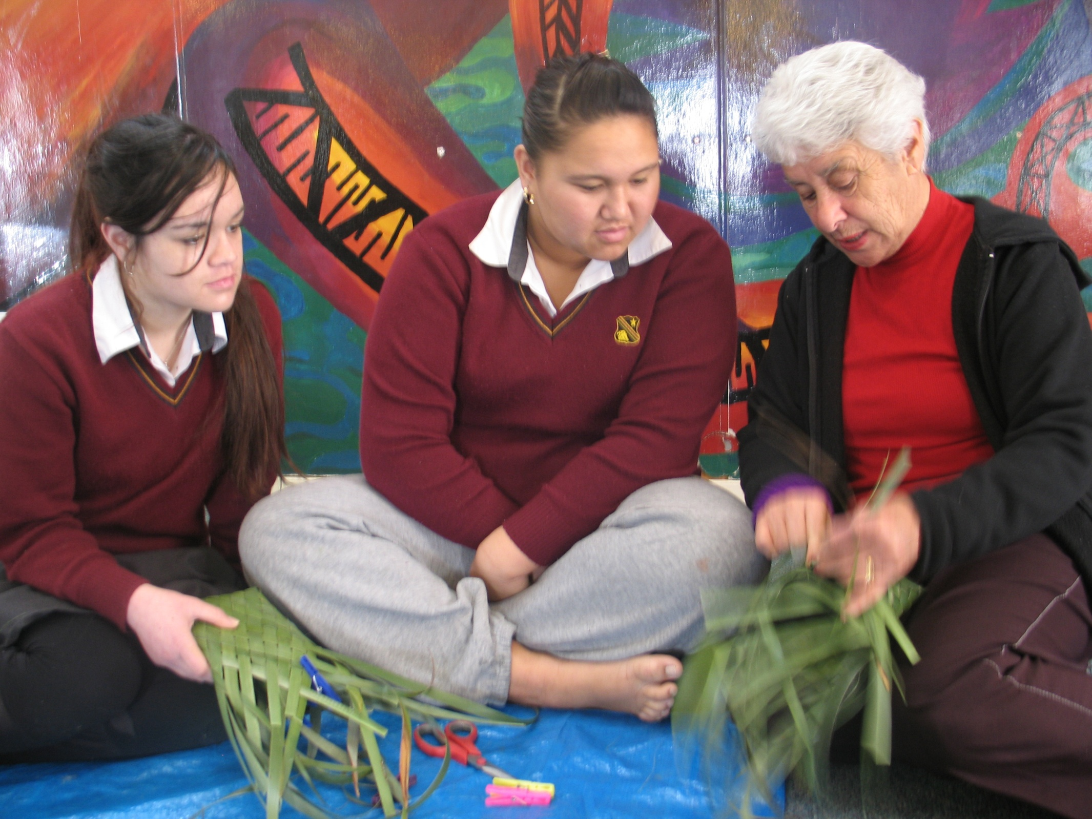
Case study: Rauawaawa Kaumatua Trust Education programme
RAUAWAAWA TRUST
Freedom from embarrassment (whakamaa) while learning amid peers
Some potential to be enterpreneurial (selling products in connected shop)
Participation in conducive setting while respecting Maaori values

Slide 11
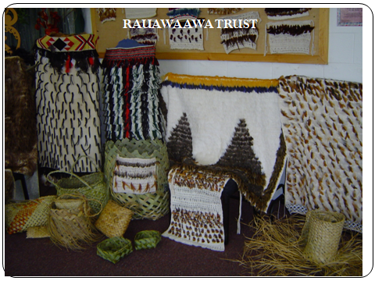

Slide 12
The relationship
Formalised in 2004 after preceding years of co-operation
Key issue: indigenous programme delivered by mainstream Pakeha provider
Agreement:
University – academic & funding approval, quality assurance, records (as expected by Tertiary Education Commission)
Trust: provides physical environment, teachers.
Reduction in funding in 2011 following 46% Govt. cuts to University continuing education

Slide 13
ACE Funding from Government: Priorities for Universities
Provide specialised & research-informed higher level learning that contributes directly to the creation of an advanced & rapidly evolving knowledge economy
Contribute to the knowledge society through the preservation, dissemination & application of university research
Promote the development of critical & reflective thinking, the active & informed citizenship locally, nationally & globally
Facilitate pathways into & through university education
Build capacity in the wider ACE sector (while having regard to the ACE professional development strategy)
Question: How does the Trust’s programme relate to these priorities?

Slide 14
Issues and threats
Tension between general and University ACE priorities- are these subject to negotiation?
Curriculum heavily oriented to a kaupapa Maori ideology
Teachers emergent from kaumatua themselves (sufficiently qualified in University terms?)
Peer learning context based on collaboration (when competitive ethos abounds)
On-going Govt. support for university-based adult education?
TEC priorities for education: under 25s, Maori and Pasifika students

