Slide 1
How Universities can demonstrate their relevance and capabilities through partnering in major sporting events
Prepare by: Anthony Davis - PhD Scholar
School of Education -University of Glasgow
Event: U21 Lifelong Learning and Research Conference
Date: May 14 – 16, 2012.

Slide 2
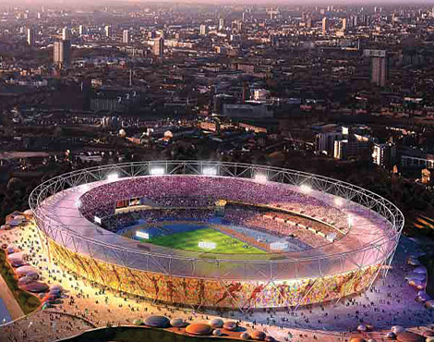
Relevance of Sport
Indicator of the power of a nation.
Roman, Ottoman, Cold war period.
Most if not all major cities skyline have large sport facilities as a famous land mark.

Slide 3
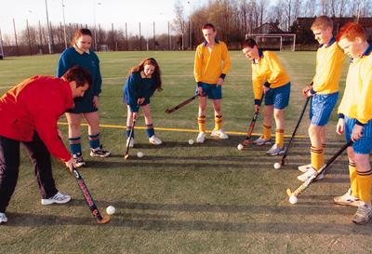
Necessity of Partnership
Sustaining growth in a changing market place is increasingly dependent on universities finding common ground in communities for growth.

Slide 4

Importance to Society
Electronic media
Dedicated sports news – sports network
Print media
Newspaper, periodicals
Notes:
Dedicated sports sections, in fact some persons may argue that without strong sport coverage success maybe limited or unsure

Slide 5
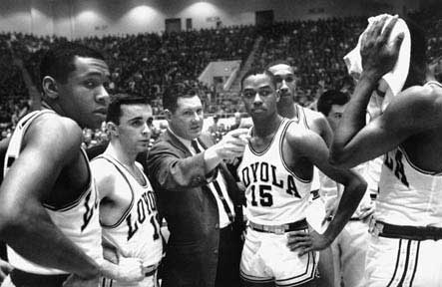
Relevance
Sports play a major role in a university’s mission of teaching, research and public service.
Lifelong lessons are taught and learned on and off the field.

Slide 6

Capabilities
Hosting competitions
Opportunities linking theory with practical application
Volunteers
In house expertise
Notes:
204 countries in the IOC

Slide 7
Benefits
All developed countries have demonstrated that sports can not only co exist with academics, but are actually intertwined in the mission of most institutions.
On an average Universities with successful sports programs have the highest enrollment figures, the highest number of applications and the international fame.
Notes:
University sports provide the opportunity to develop the total person – if marketed properly sports can generate more income than tuition

Slide 8
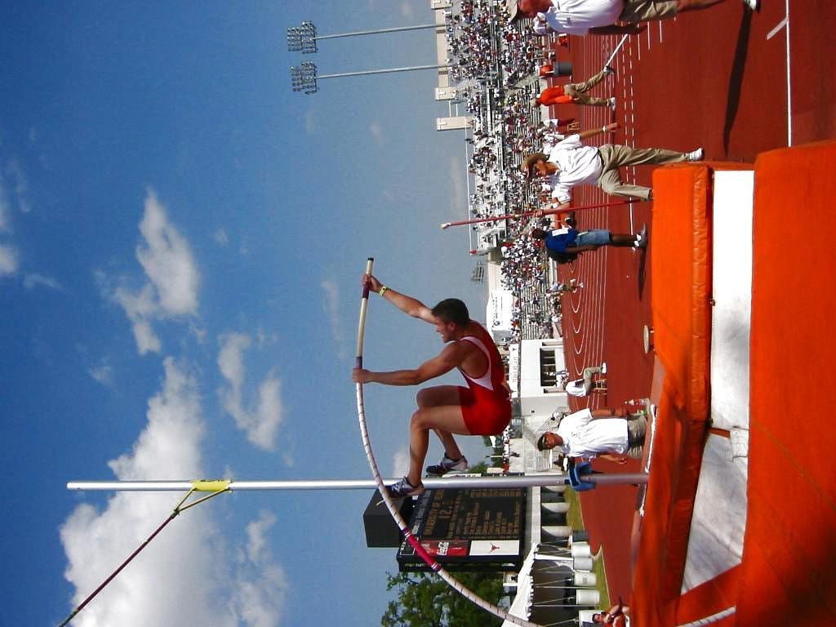
The will
The challenge is to have sport assume its proper role in university education to reflect the mission and values of universities.

