Slide 1
Pacific Island Community
‘Engaged Outreach’
Case Study
Prof Michael Cuthill
Chair, Regional Community Development
University of Southern Queensland
Australia

Slide 2
Context
Research design
Research results:
* Contextual factors
* Key issues
* Flow on impacts
Conclusions

Slide 3
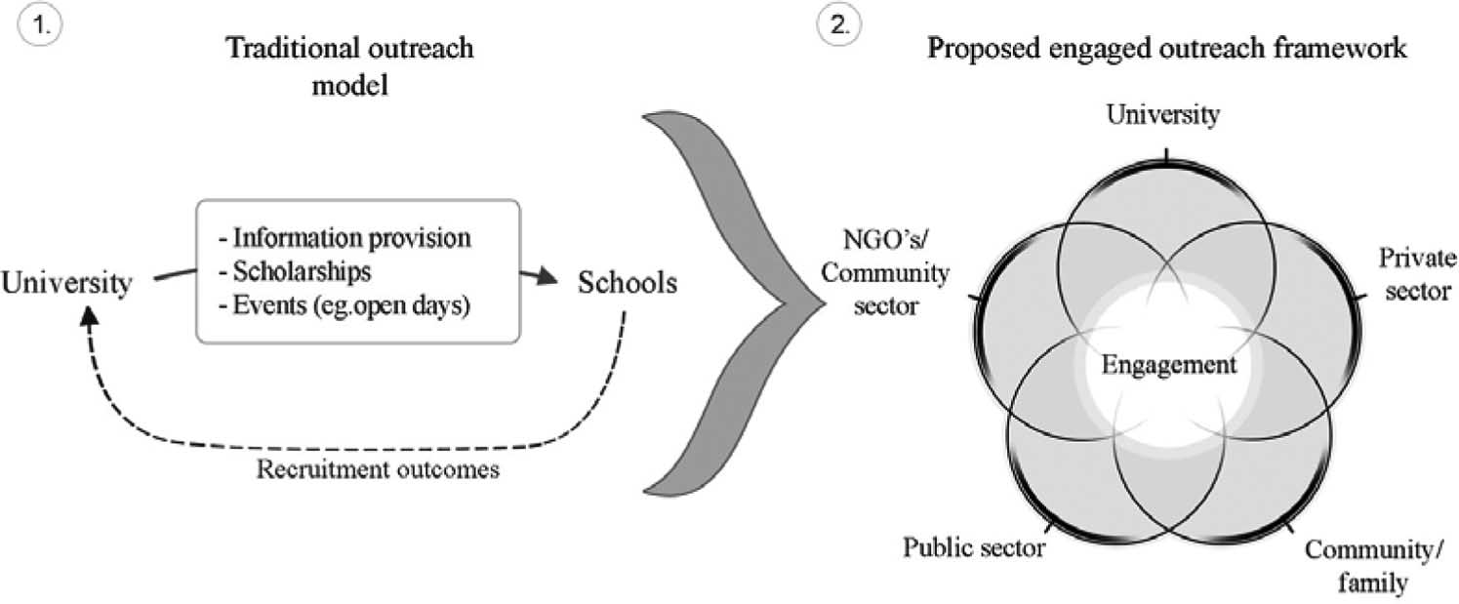

Slide 4
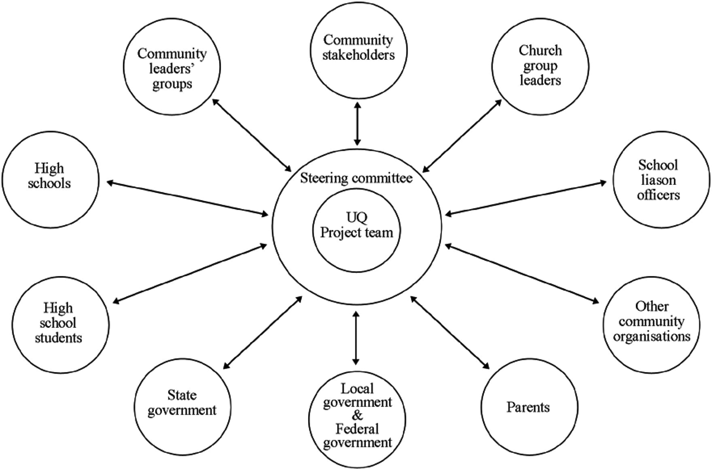

Slide 5
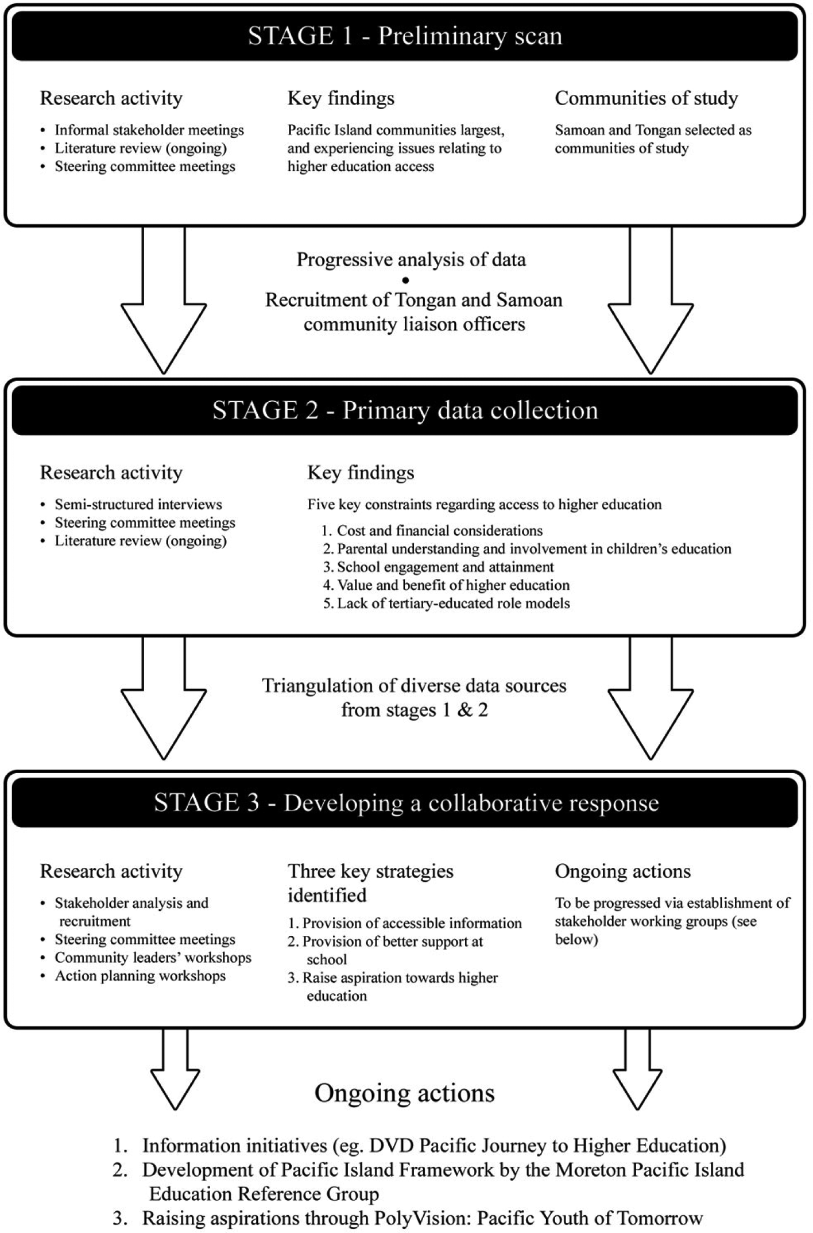

Slide 8
Contextual factors
Structural issues
Settlement issues
Social issues
Community values
Spheres of influence
Community strengths

Slide 9
Five key issues affecting PI access
… cost and financial considerations
… parental involvement
… school engagement and attainment
… perceived benefit of higher education
… relatively few role models

Slide 10
Flow on actions arising from using engaged outreach
… schools PI capacity building strategy
… information DVD
… liaison officer
… information event and celebration
… immigrant entry requirements adapted
… subsequent projects implemented

Slide 11
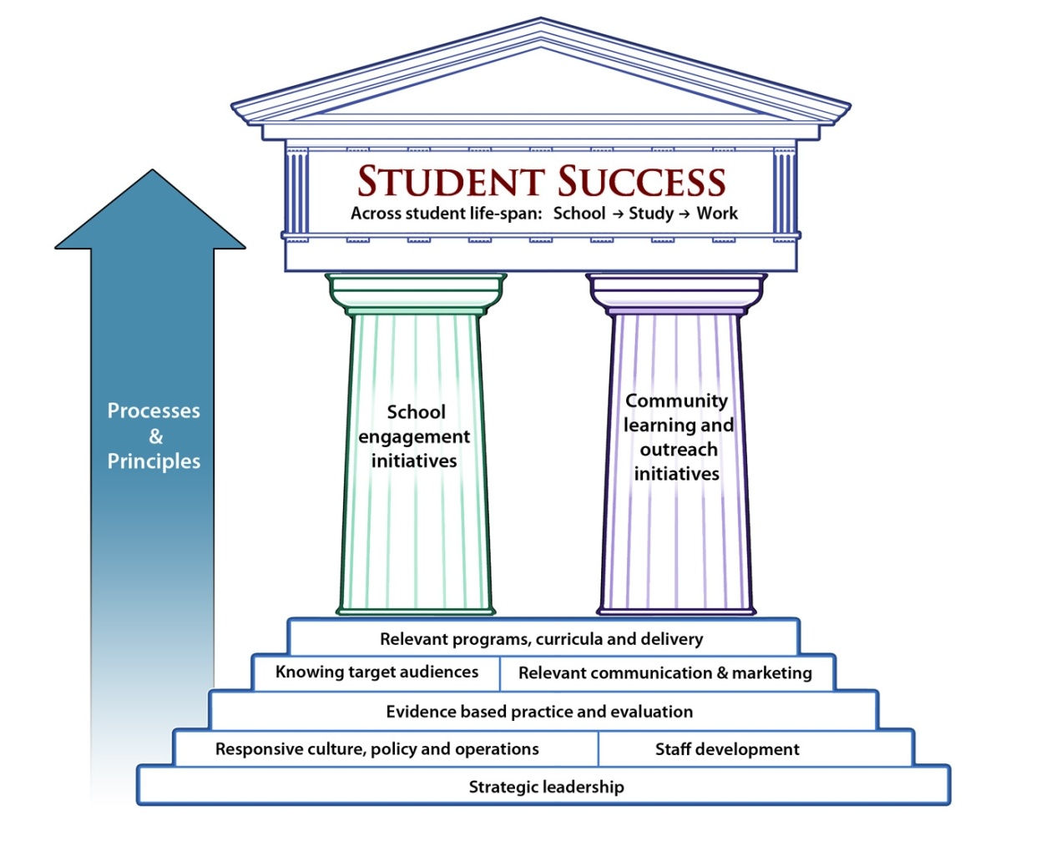

Slide 12
Key challenges for research intensive universities

Slide 13
Cuthill, M. 2011 ‘Embedding engagement in an Australian ‘sandstone’ university: From community service to university engagement’ Metropolitan Universities 22:2, pp.21-44.
Cuthill, M. & Schmidt, C. 2011 ‘Widening participation: Challenges confronting an Australian research intensive university’ Journal of Institutional Research 16:2, pp.13-25.
Cuthill, M. & Scull, S. 2011 ‘Going to university: Pacific Island migrant perspectives’ Australian Universities Review 53:1, pp.5-13.
Cuthill, M. & Brown, A. 2010 ‘Sceptics, Utilitarians and Missionaries: Senior managers perceptions of engagement in an Australian Research University’ The Australasian Journal of University-Community Engagement 5:2, pp.126-146.
Cuthill, M. 2010 ‘Working together: A methodological case study of engaged scholarship’ Gateways: International Journal of Community Research and Engagement 3, pp.20–37.
Scull, S. & Cuthill, M. 2010 ‘Engaged outreach: Using community engagement to facilitate access to higher education for people from low socio-economic backgrounds’ Higher Education Research and Development 29:1, pp.59-74.
Scull, S. & Cuthill, M. 2008 ‘PolyVision: Pacific Youth of Tomorrow. A collaborative partnership between the University of Queensland and Pacific Island immigrant communities in Australia’ Journal of Widening Participation and Lifelong Learning 10:3, pp.35-38.
Cuthill, M. 2008 ‘A quality framework for university engagement in Australia’ International Journal for Public Participation 2:2, pp.22-41, online http://www.iap2.org/displaycommon.cfm?an=1&subarticlenbr=307

